Slide 1
Mesh-based Dynamics with Occlusion Reasoning for Cloth Manipulation
RSS 2022

Slide 2
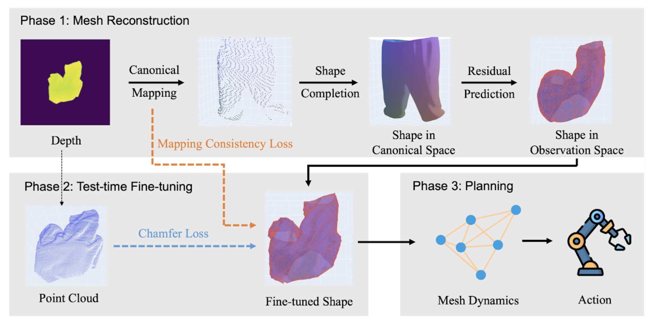
Pipeline
Pipeline
Mesh
Occlusion
Reasoning
Dynamics

Slide 3
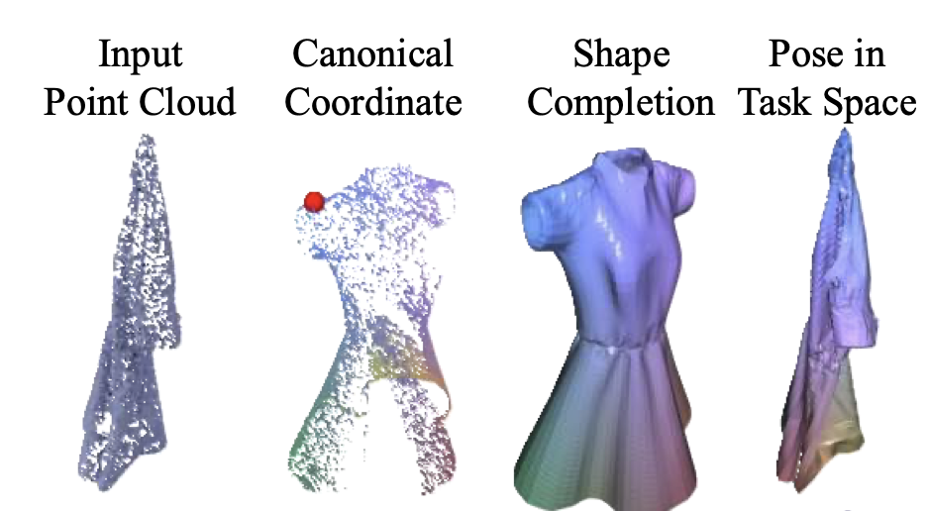
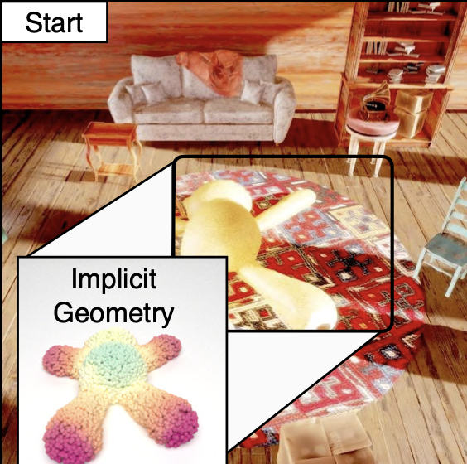
Model construction
Model-based
Lift up the cloth
Implicit geometry
GarmentNets: Category-Level Pose Estimation
for Garments via Canonical Space Shape Completion
ICCV 2021
ACID: Action-Conditional Implicit Visual
Dynamics for Deformable Object Manipulation
RSS 2022 Best Student Paper

Slide 4
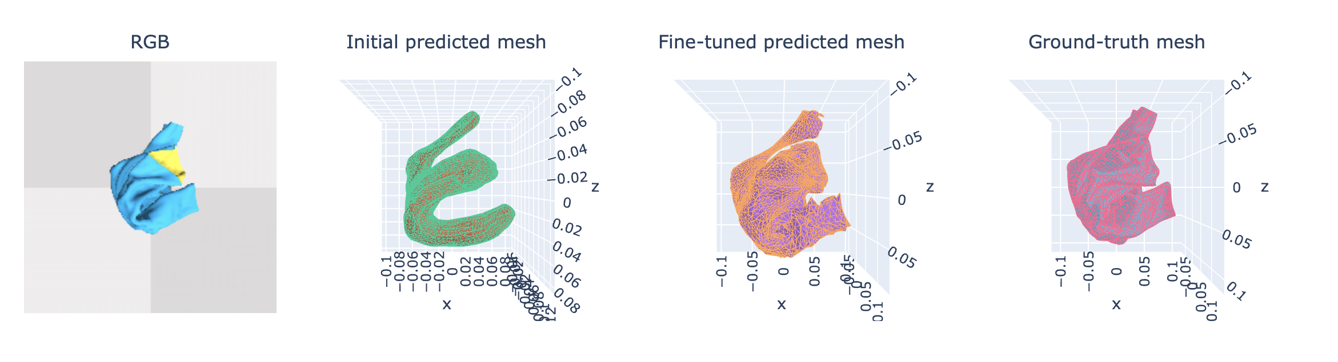
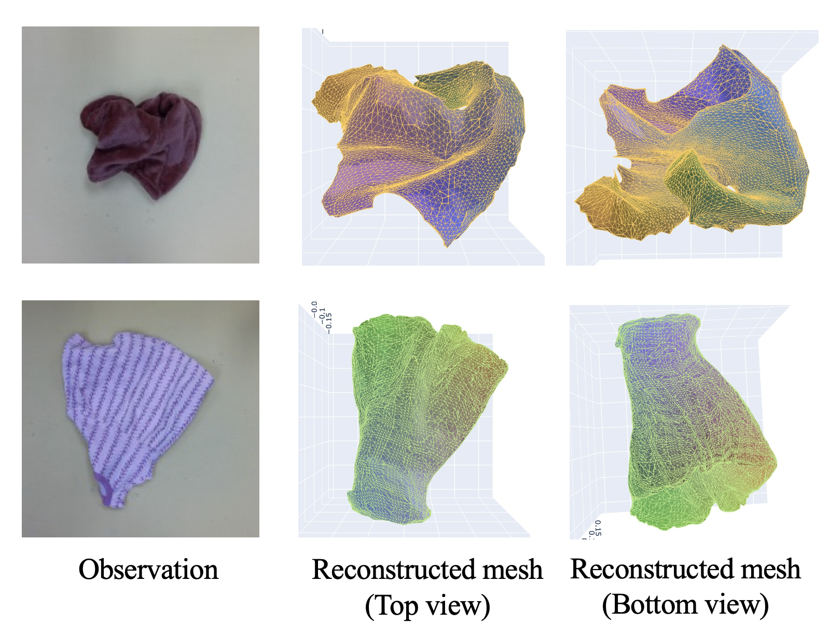
Model construction
Model-based
Crumpled states
Given only a partial observation of a crumpled cloth,
generate a complete mesh of the cloth.

Slide 5
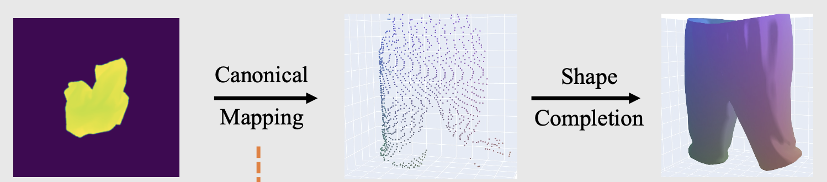
Model construction
Model-based
Mapping to canonical state
Depth
Visible points in Canonical Space
Shape in Canonical Space
Trained in a category-dependent manner

Slide 6
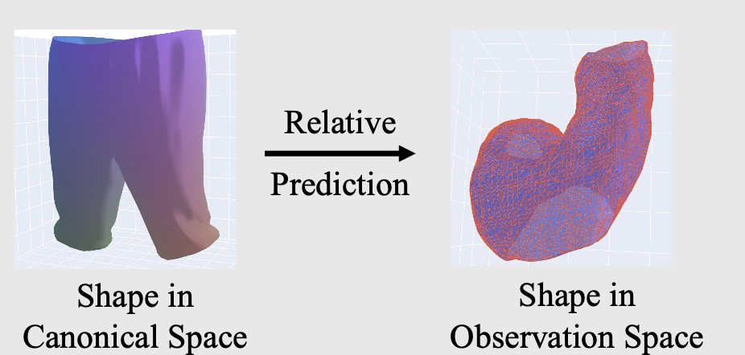
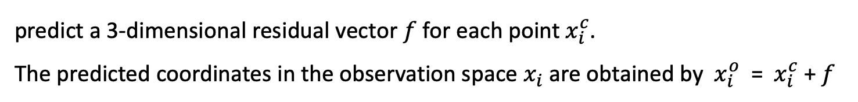
Model construction
Model-based
Relative predictions
predict a 3-dimensional residual vector $f$ for each point${ x}_{i}^{c}$.
The predicted coordinates in the observation space $x_{i}$ are obtained by ${ x}_{i}^{o}$ = ${ x}_{i}^{c}$ + $f$
Trained in a category-dependent manner

Slide 7
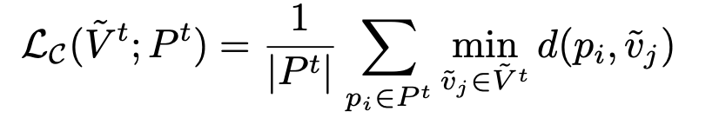
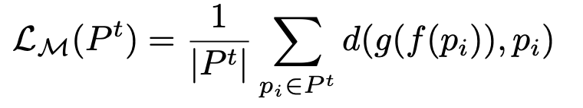
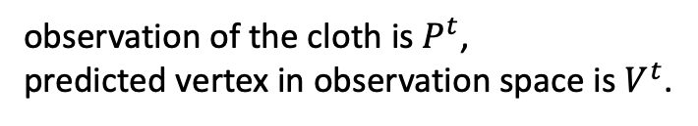
Model construction
Model-based
GT
Refine
Test-time finetuning
Unidirectional Chamfer loss
observation of the cloth is $P^{t}$,
predicted vertex in observation space is $V^{t}$.
Mapping consistency loss

Slide 8
Pipeline
Pipeline
Mesh
Occlusion
Reasoning
Dynamics

Slide 9
Mesh-based Dynamics
Dynamic
Dynamic model
Given a down-sampled mesh from reconstruction.
A GNN encodes the input feature on the nodes and on the edges and then
conducts multiple message passing steps between the nodes and edges.
The decoder will decode the latent features of each node into
the predicted acceleration for that node.
Trained only on Trousers

Slide 10
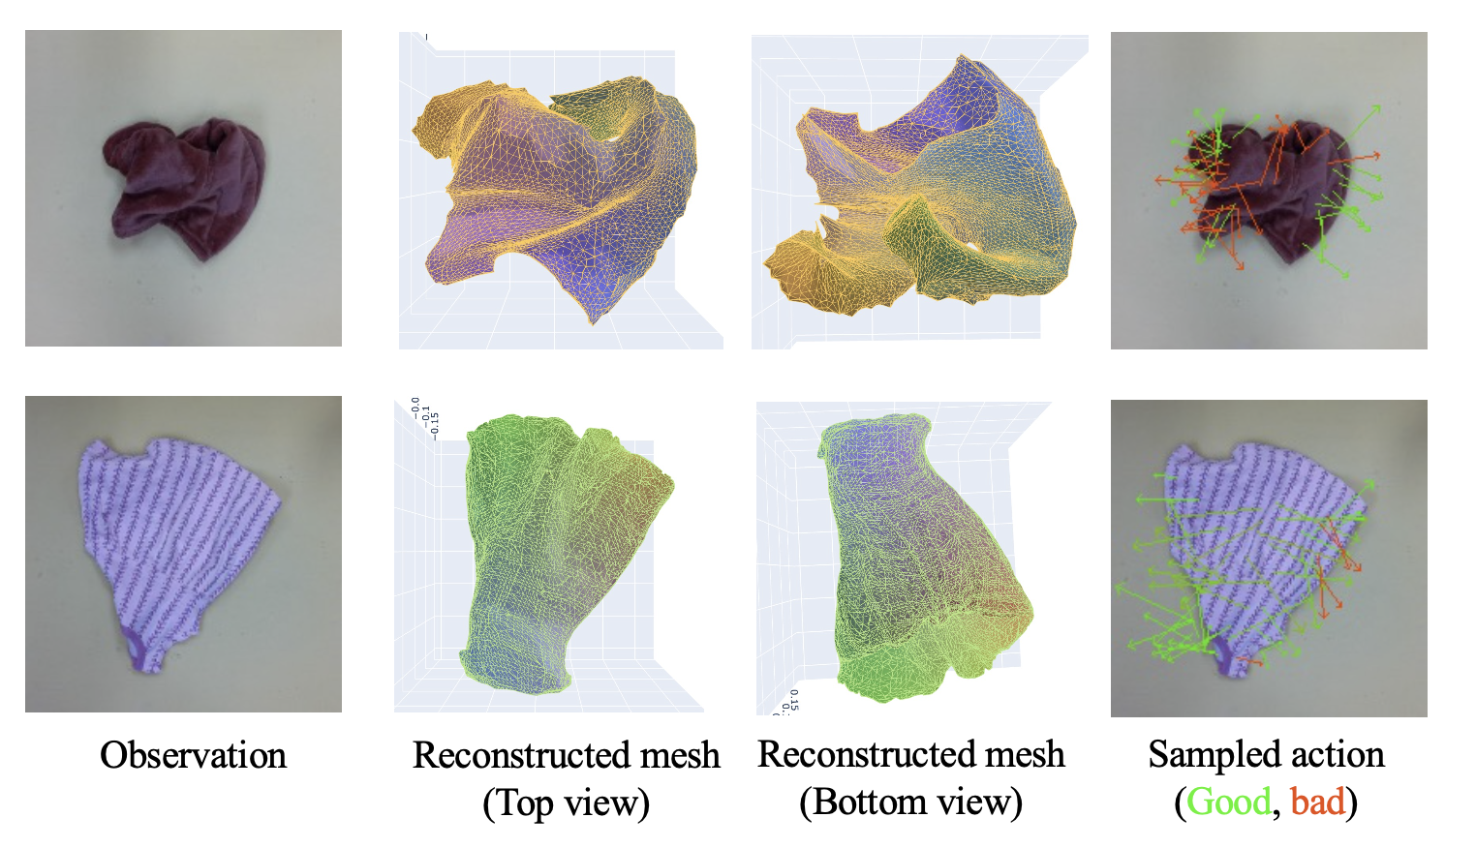
Mesh-based Dynamics
Dynamic
Planning
Randomly sample 500 pick-and-place actions and rollout each action with
the GNN dynamics model and pick the action with the highest predicted reward

Slide 11
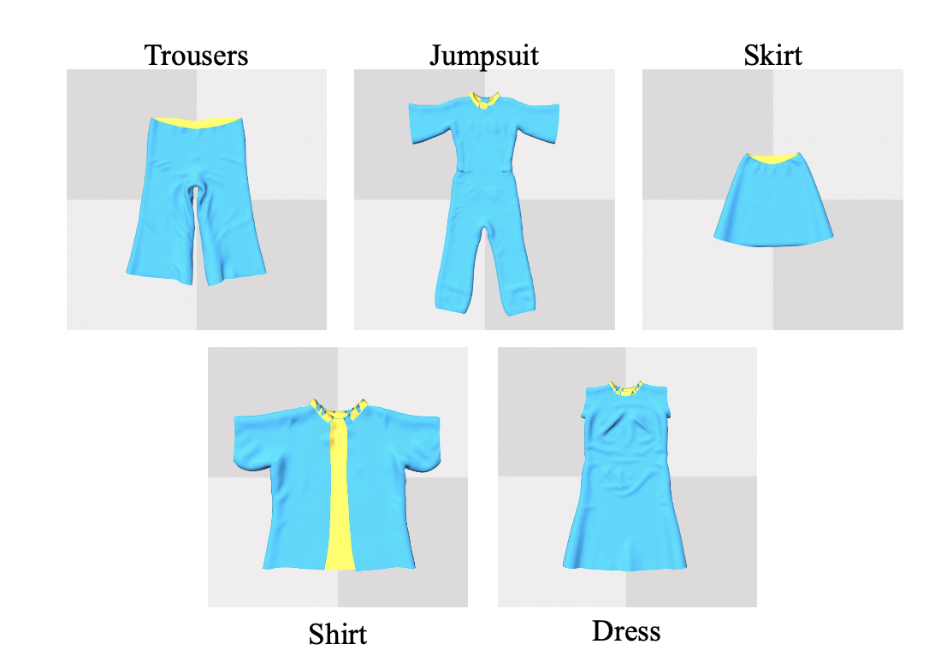
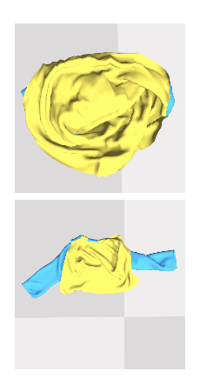
Data and tasks
Experiments
Cloth3D in SoftGym
Flattening and Canonicalization
Real robot

Slide 12
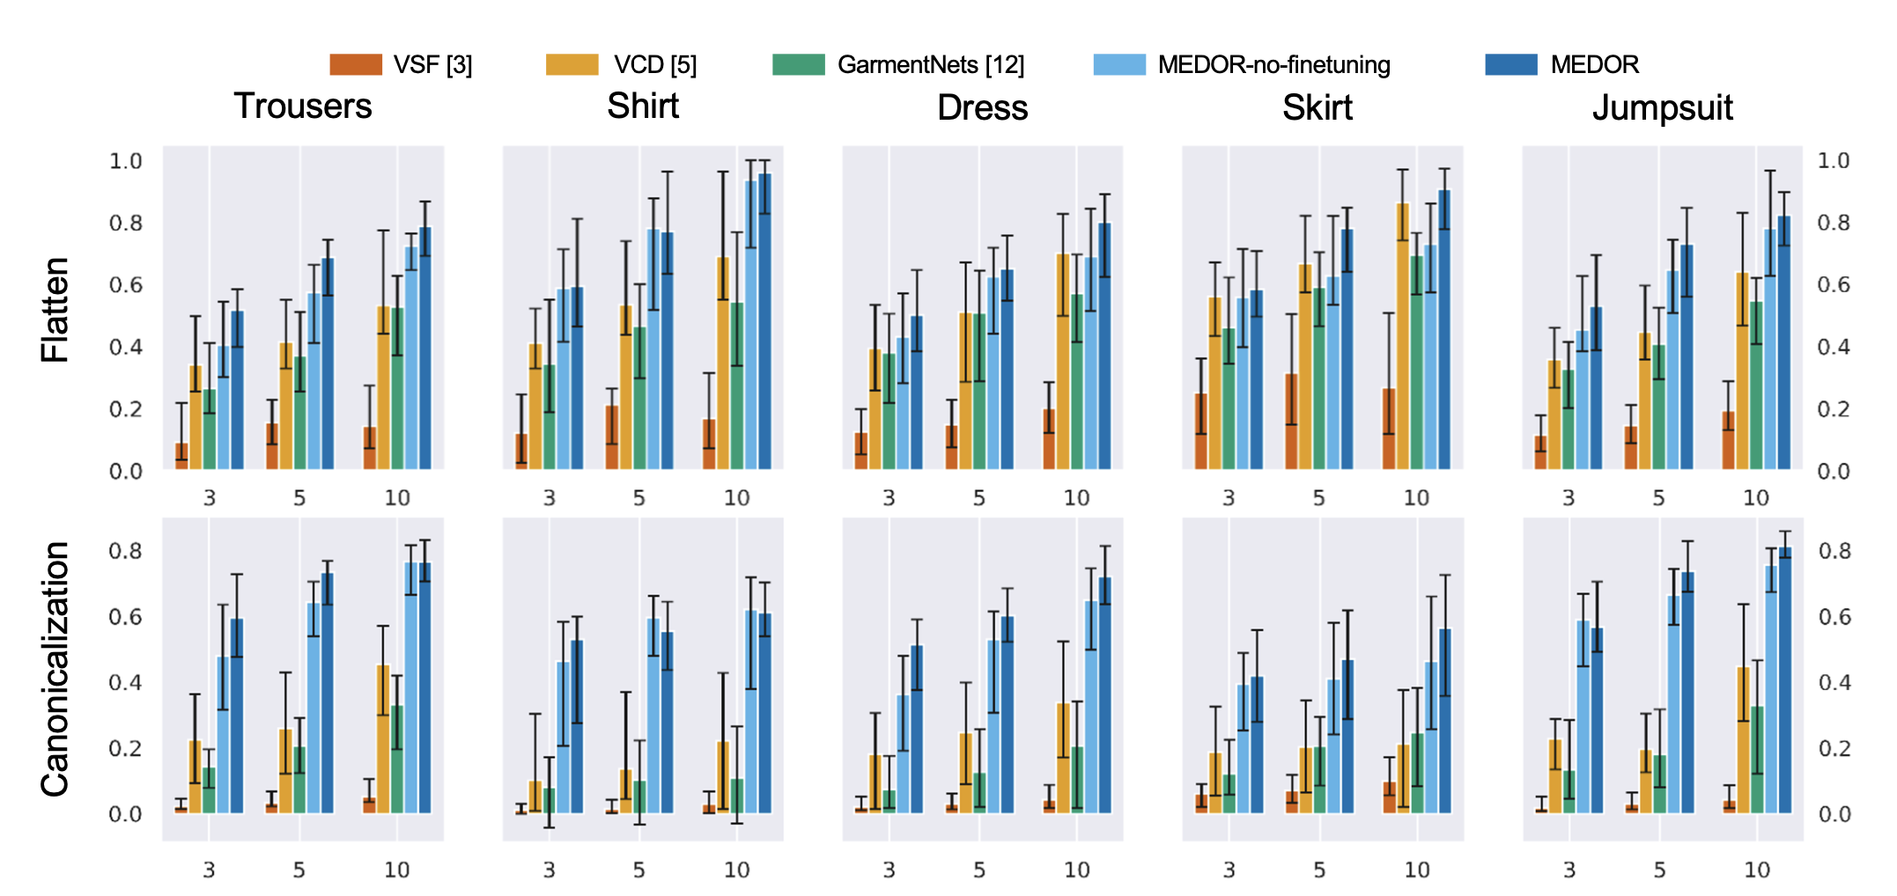
Results
Experiments
With baseline

Slide 13
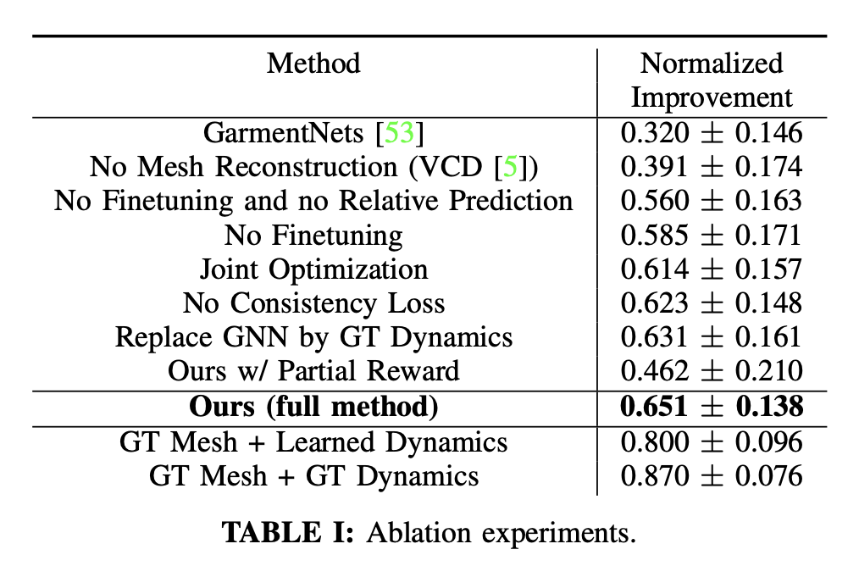
Results
Experiments
Ablations

Slide 14
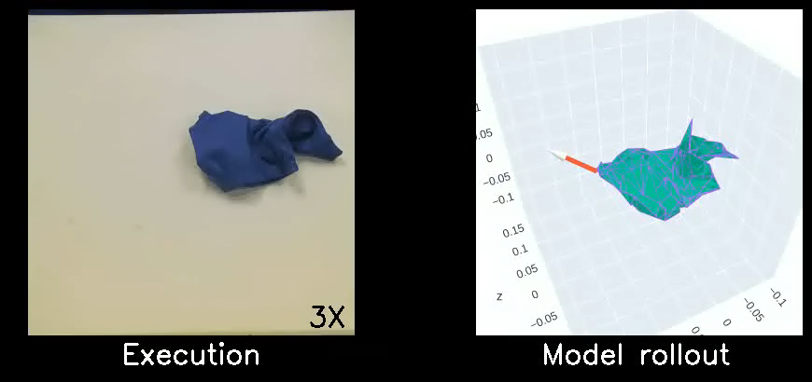
Results
Experiments
Real robot

Slide 15
Conclusions
Conclusions
Model-based approach
Low level dynamic

